Slide 1
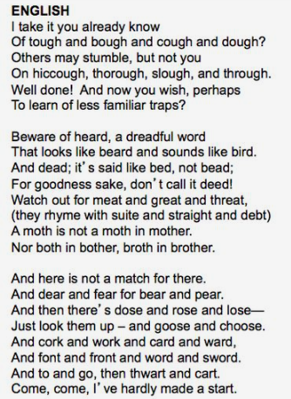
Can you read this?

Slide 2
Parent Meeting
Phonics Screening Check

Slide 3
Is this session, we will discuss:
Phonics
The Phonics Screening Check
How we teach children to read words
How you can support your children at home

Slide 4
Reading changes everything
Teach a child to read and keep that child reading and we will change everything.
And I mean everything.
Jeanette Winterson
https://youtu.be/p_6Jb0-3qz8
https://youtu.be/MbWIujM1WGM
Notes:
By the end of Year 1, we want all of our children to be able to read accurately – to read both familiar and unfamiliar words - so that they can go on to become a fluent, enthusiastic reader. To do this, we teach the children phonics.
Here are some quick videos to help us understand what Phonics is.
The Phonics Screening Check in June is a word reading test to check children can read sounds in words accurately. The reason why this is carried out is because research suggests that accurate word reading at 6 is a predictor of future success.

Slide 5
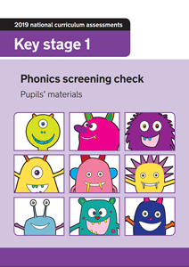
What is the Phonics Screening Check?
A word-reading test at the end of Year 1.
Children read 40 words.
W/C Monday 8th June 2026
http://schools.ruthmiskin.com/training/view/60XCj1Iw/MvkG9WVr
Notes:
Children complete the phonics screening check at the end of Year 1 so that parents can be confident their children are being taught to read successfully.
Children read 40 words. It takes between two and five minutes.
If they do not manage to read 32 of the words successfully, they are given extra support, and repeat the check at the end of Year 2. This means that some of our Year 2s will be taking the test again this year.

Slide 6
How do we teach Phonics: Speed Sounds
Notes:
Children learn all of the sounds on this chart.
Once they know all of these sounds, they will be able to read any unfamiliar word.

Slide 7

How do we teach Phonics:
‘Special Friends’, ‘Fred Talk’
Notes:
We teach children to words using the routine ‘Special Friends’, ‘Fred Talk’, read the word’.
Children spot the ‘Special Friends’ (two letters that make one sound), Fred talk the word, and then read the whole word.
For example, ‘sh’, sh-i-p, ship.

Slide 8



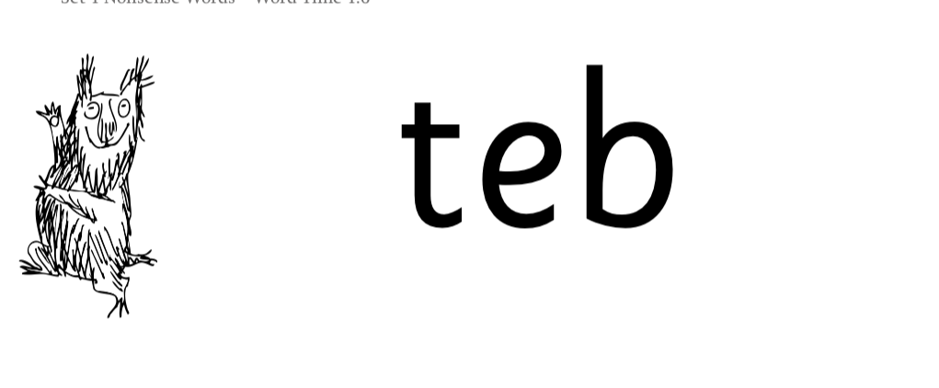
How do we teach Phonics: Nonsense words
Notes:
Half of the words in the check are real words.
Half are nonsense words. For example, ‘sheb’, ‘glight’, ‘ched’, ‘teb’.
There is a picture of an alien next to each word to remind the children that it isn’t a real word.
Nonsense words are used to assess children’s reading.
They check that children will be able to read sounds the sounds they know in unfamiliar words.
They read these words using the same routine as real words – ‘Special Friends, Fred Talk.’
Children who can read nonsense words will, very soon, be able to read any new word – for example – gargantuan, flailing, raucous, anticipation;
Reading new words increases children’s vocabulary rapidly.

Slide 9





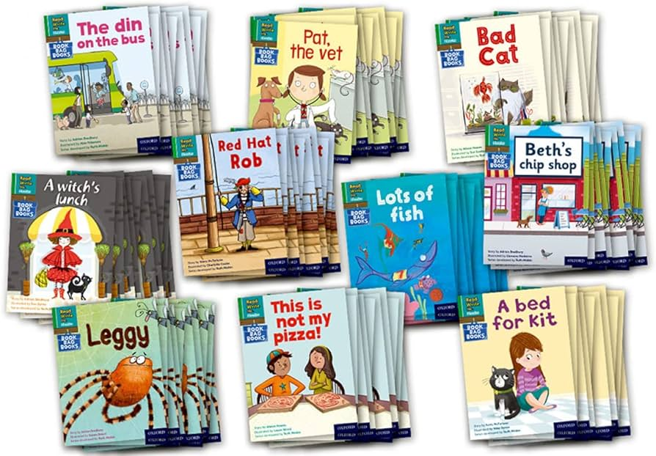
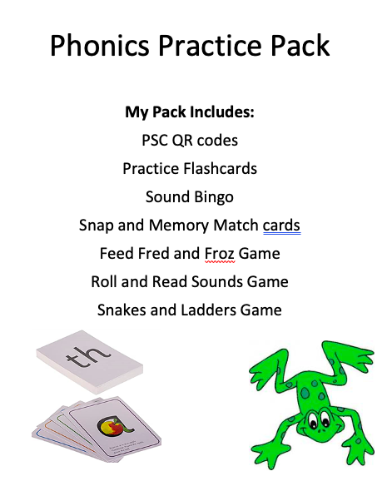
Practice at home
Notes:
Listen to your child read their Read Write Inc Book every day. Reading or listening to the same book more than once is not a bad thing – in fact, it is important for children. Re-reading lets them see or hear words and phrases enough times to remember them, and also helps them to develop their fluency, comprehension and expression.
When reading with your child, remind them to ‘Special Friends, Fred Talk, Read The Word’ to support them in segmenting and blending unknown words. Special friends are a combination of two or three letters representing one sound, e.g. ck, ay, igh, oa. Fred Talk means the children sound out the word e.g. sh-i-p.
Use the activity pack to play games that support your child further, in the run-up to the Phonics Screening Check.
You can purchase Set 2/3 flashcards on amazon, to support your child with sounds at home if you wish.

Slide 10
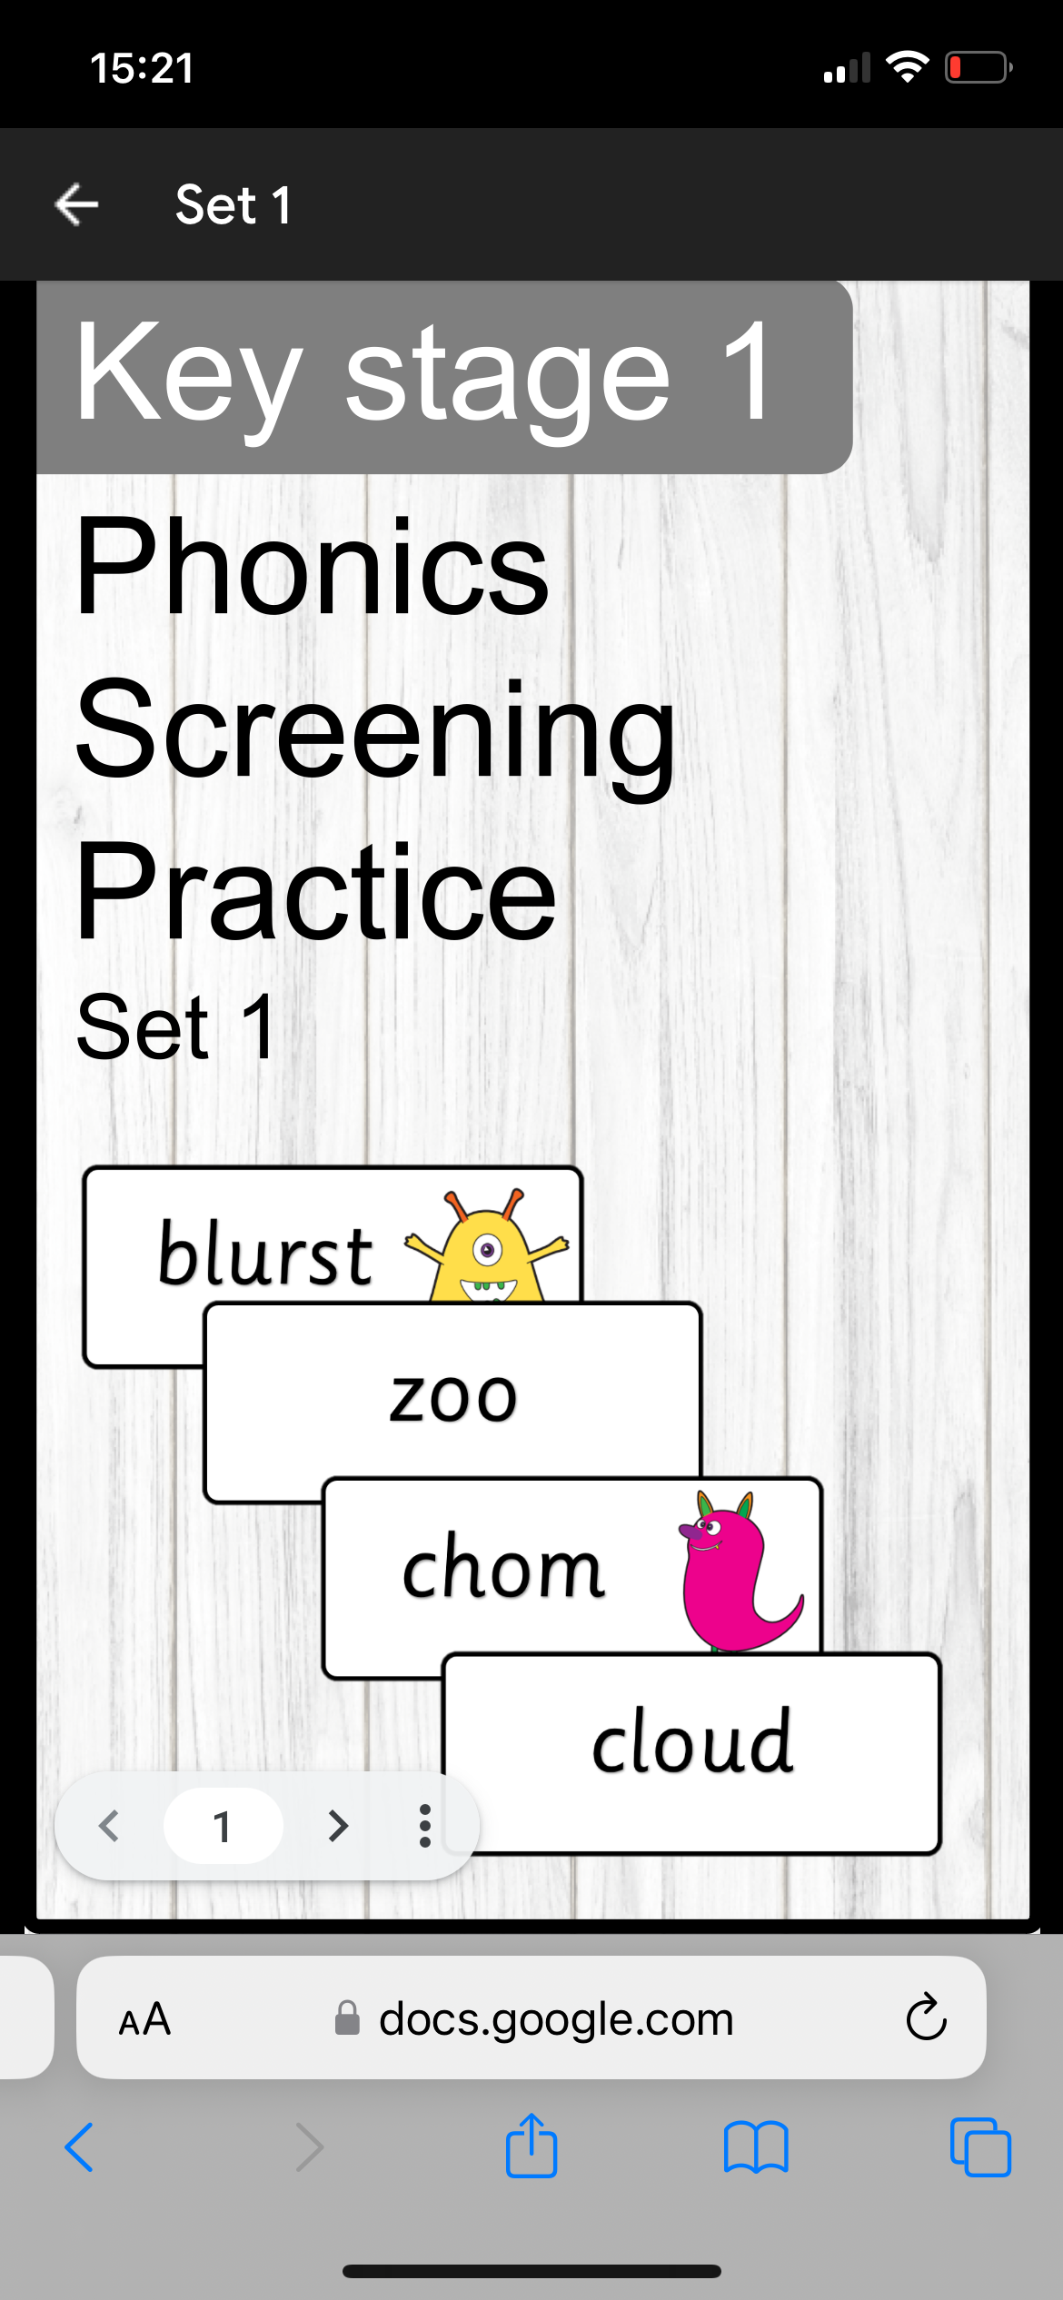
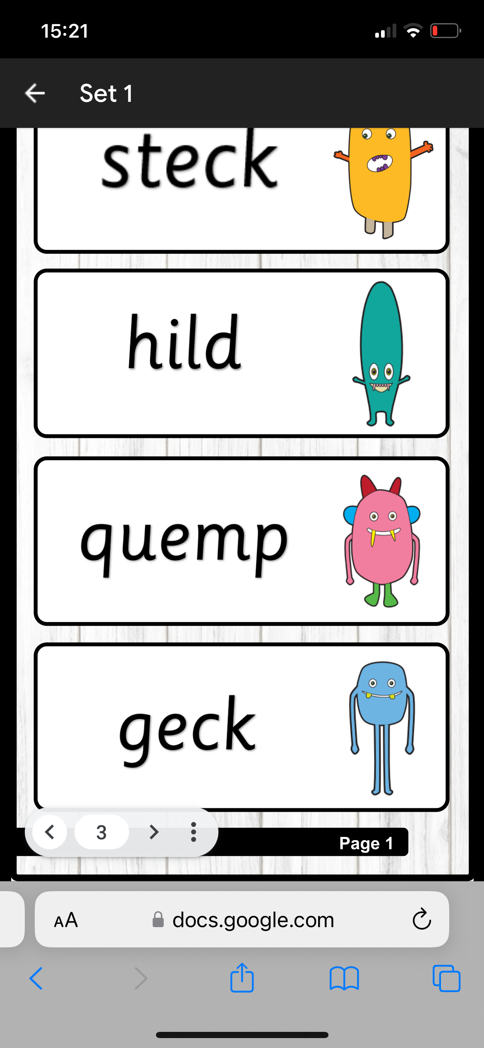
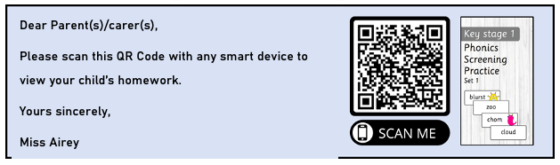
Online resources available
Phonics Screening Check Practice
- Scan the QR codes in the activity pack, to access 8 different Phonics Screening Checks on your device.
Notes:
In the activity pack, you will also have a page with 8 QR codes which, when scanned, will take you to a document just like the ones on the screen where you can get your children to practice word reading at home in a style similar to the PSC.

Slide 11
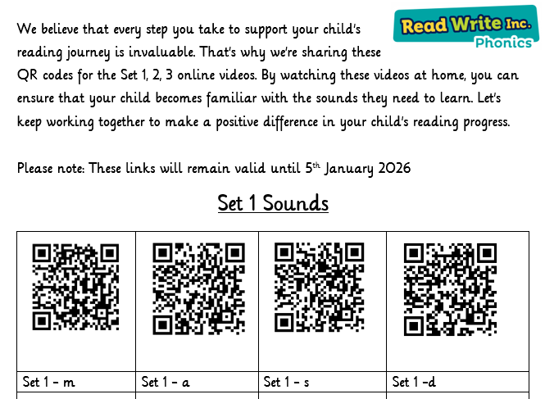
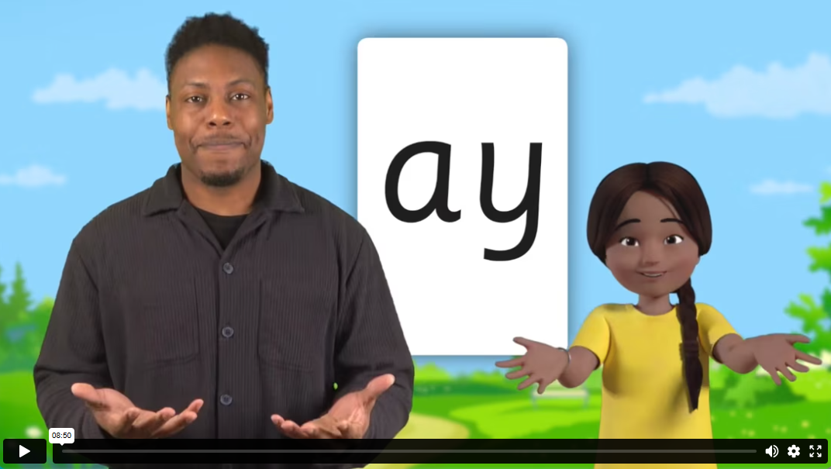
RWI Sound Lesson QR Codes

Slide 12
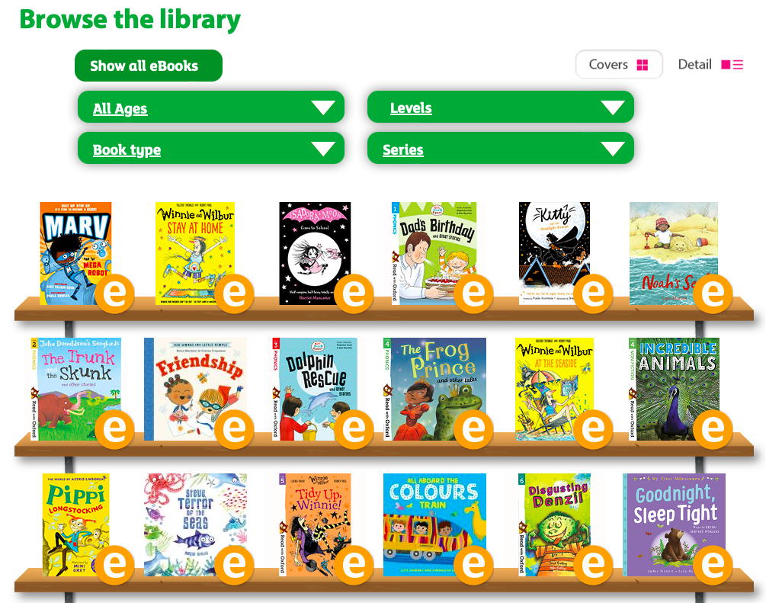
Online resources available
Free e-books for home reading:
https://www.oxfordowl.co.uk/for-home/find-a-book/library-page/
Notes:
There are also a wide variety of free e-books available that can be used for home reading. This link is also available in the activity pack provided. For this resource, you just have to follow the link, create an account as a parent and then you should be able to access a range of rich texts to support your children.

Slide 13
Reading changes everything
Teach a child to read and keep that child reading and we will change everything.
And I mean everything.
Jeanette Winterson
Notes:
Remember that all adults that work with and support children have the power to change outcomes for children.

Slide 14

Any questions?

